Slide 1

Pizza Sales Analysis
Presented By:
Chandana A

Slide 2
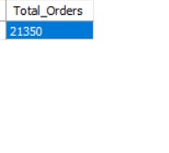
Retrieve the total number of orders placed
SELECT count(order_id) AS Total_Orders
FROM orders;

Slide 3
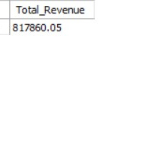
Calculate the total revenue generated from pizza sales.
SELECT round(SUM(quantity*price),2) AS Total_Revenue
FROM Order_Details od
JOIN Pizzas p ON od.pizza_id = p.pizza_id;

Slide 4
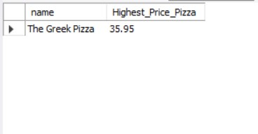
Identify the highest-priced pizza
SELECT pt.name, p.price AS Highest_Price_Pizza
FROM pizza_types pt
LEFT JOIN pizzas p ON pt.pizza_type_id=p.pizza_type_id
ORDER BY price DESC
LIMIT 1;

Slide 5
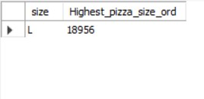
Identify the most common pizza size ordered
SELECT p.size, sum(od.quantity) AS Highest_pizza_size_ord
FROM order_details od
LEFT JOIN pizzas p
ON od.pizza_id=p.pizza_id
GROUP BY p.size
ORDER BY Highest_pizza_size_ord
DESCLIMIT 1;

Slide 6
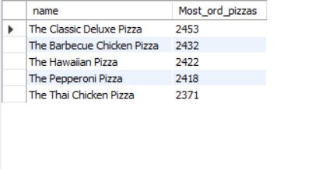
List the top 5 most ordered pizza types along with their quantities.
SELECT pt.name, sum(od.quantity) AS Most_ord_pizzas
FROM order_details od
LEFT JOIN pizzas p ON od.pizza_id=p.pizza_id
JOIN pizza_types pt ON p.pizza_type_id=pt.pizza_type_id
GROUP BY pt.name
ORDER BY Most_ord_pizzas DESC
LIMIT 5;

Slide 7
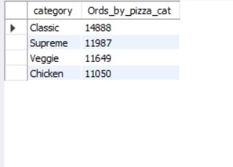
Join the necessary tables to find the total quantity of each pizza category ordered.
SELECT pt.category,sum(od.quantity) AS Ords_by_pizza_cat
FROM order_details od
LEFT JOIN pizzas p ON od.pizza_id=p.pizza_id
JOIN pizza_types pt ON p.pizza_type_id=pt.pizza_type_id
GROUP BY pt.category
ORDER BY Ords_by_pizza_cat DESC
;

Slide 8
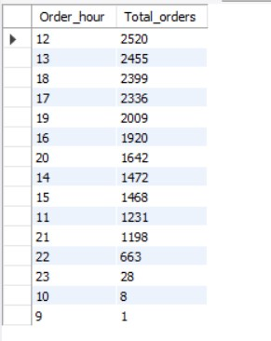
Determine the distribution of orders by hour of the day
SELECT HOUR(time) AS Order_hour,
count(order_id) AS Total_orders
FROM orders
GROUP BY HOUR(time)
ORDER BY Total_orders DESC ;

Slide 9
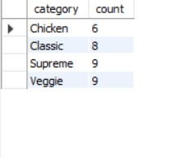
To find the category-wise distribution of pizzas
SELECT category, count(category) AS count
FROM pizza_types
GROUP BY category;

Slide 10
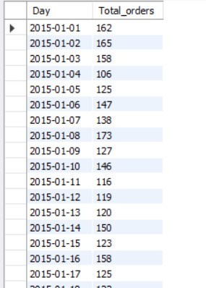
Group the orders by date and calculate the average number of pizzas ordered per day
SELECT date AS Day, sum(od.quantity) AS Total_orders
FROM orders o
LEFT JOIN order_details od ON o.order_id=od.order_id
GROUP BY date;

Slide 11
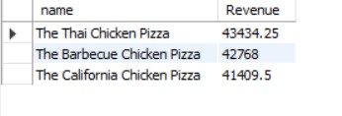
Determine the top 3 most ordered pizza types based on revenue
SELECT pt.name, sum(quantity*price) AS Revenue
FROM order_details od
LEFT JOIN pizzas p ON od.pizza_id=p.pizza_id
JOIN pizza_types pt ON p.pizza_type_id=pt.pizza_type_id
GROUP BY pt.name
ORDER BY Revenue DESC
LIMIT 3
;

Slide 12
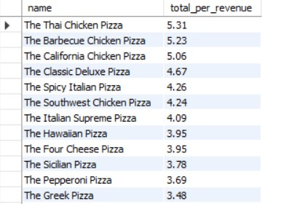
Calculate the percentage contribution of each pizza type to total revenue
WITH total_revenue_cte AS (
SELECT ROUND(SUM(od.quantity * p.price), 2) AS total_revenue
FROM order_details od
JOIN pizzas p ON od.pizza_id = p.pizza_id
)
SELECT pt.name,
ROUND((SUM(od.quantity * p.price) / tr.total_revenue) * 100, 2) AS
total_per_revenue
FROM order_details od
JOIN pizzas p ON od.pizza_id = p.pizza_id
JOIN pizza_types pt ON p.pizza_type_id = pt.pizza_type_id
CROSS JOIN total_revenue_cte tr
GROUP BY pt.name, tr.total_revenue
ORDER BY total_per_revenue DESC;

Slide 13
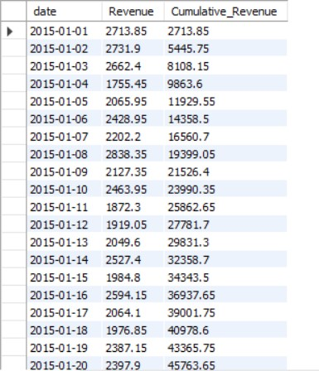
Calculate daily revenue using CTE
WITH RevenuePerDate AS (SELECT o.date,
ROUND(SUM(quantity * price), 2) AS Revenue
FROM orders o
JOIN order_details od ON o.order_id = od.order_id
JOIN pizzas p ON od.pizza_id = p.pizza_id
GROUP BY o.date
)
-- Calculate cumulative revenue
SELECT date,Revenue, ROUND(SUM(Revenue) OVER
(ORDER BY date), 2) AS Cumulative_Revenue
FROM RevenuePerDate
ORDER BY date;

Slide 14
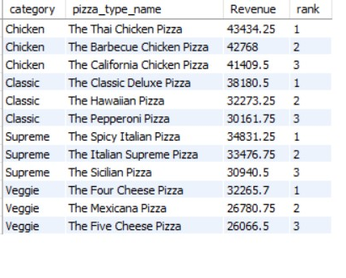
Calculate the revenue generated by each pizza type grouped by category and type
WITH RevenuePerPizzaType AS (
SELECT pt.category, pt.name AS pizza_type_name,
ROUND(SUM(od.quantity * p.price), 2) AS Revenue
FROM pizza_types pt
JOIN pizzas p ON pt.pizza_type_id = p.pizza_type_id
JOIN order_details od ON od.pizza_id = p.pizza_id
GROUP BY pt.category, pt.name
)
SELECT category, pizza_type_name, Revenue, `rank`
FROM ( SELECT category, pizza_type_name, Revenue,
ROW_NUMBER() OVER (PARTITION BY category ORDER BY Revenue
DESC) AS `rank` -- Generate rank within each category
FROM RevenuePerPizzaType
) ranked_pizzas
WHERE `rank` <= 3;

Slide 15
THANK YOU
NAGA CHANDANA A
a.chandana1709@gmail.com
https://www.linkedin.com/in/chandana-adusumalli/
https://github.com/Chandana9440

